Slide 1

Zomato Clone
GitHub Repository Link:
https://github.com/PremSagarC/Zomato-Clone.git

Slide 2
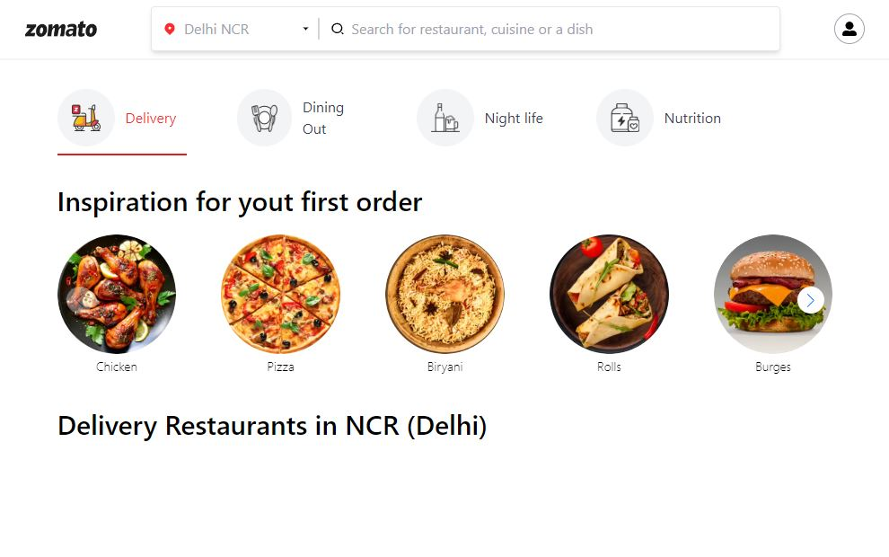
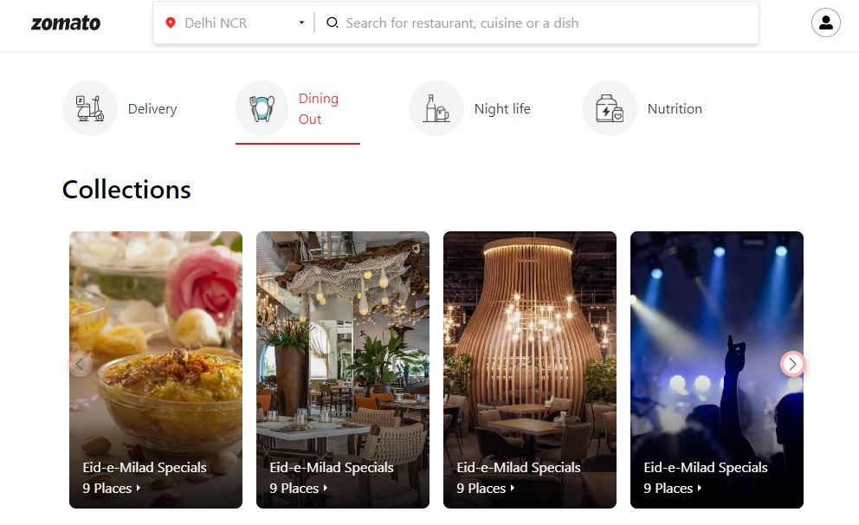
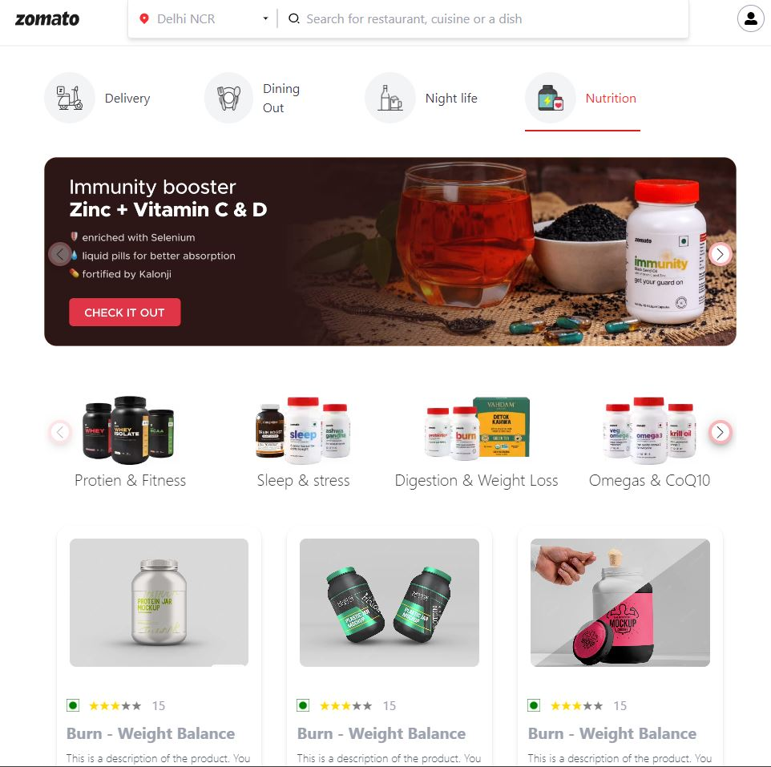
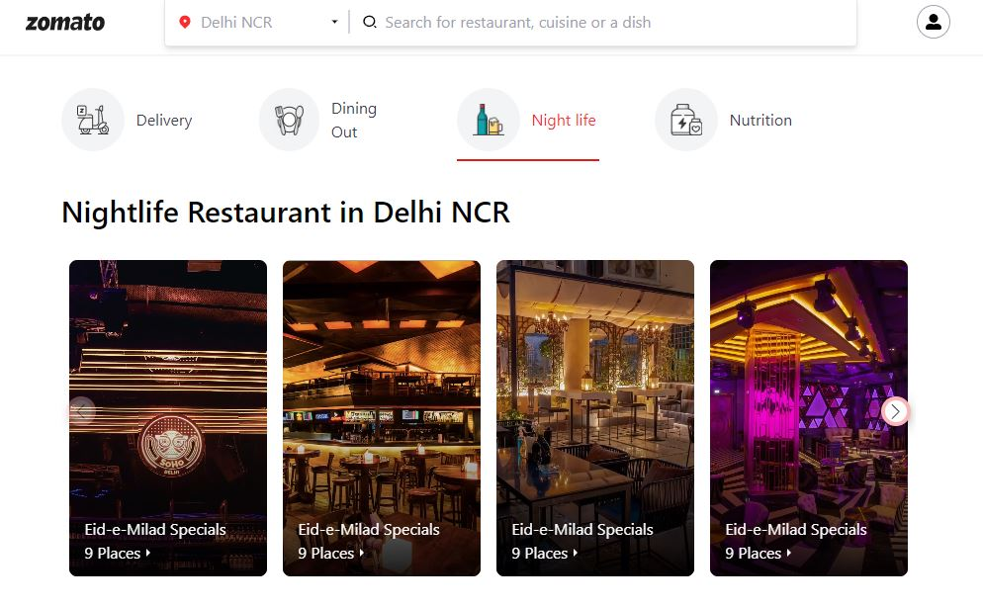
Front End Of Zomato Clone
Dining Front End
Delivery Front End
Healthy Foods Front End
Night Life Front End

Slide 3

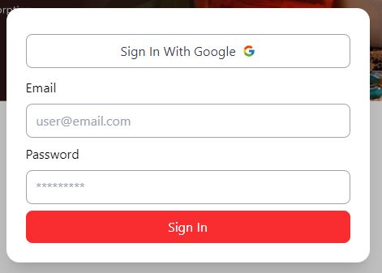
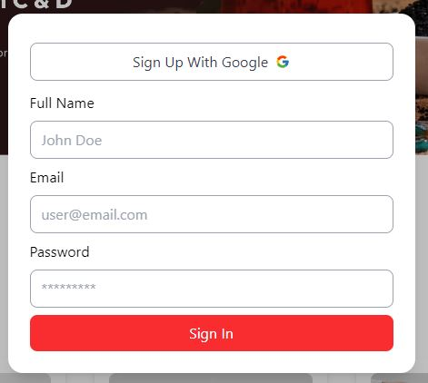
Login Page And Signup
Login Front End
Signup Front End

Slide 4
Backend Of Zomato Clone
Connecting the server side to any data base to store all the data is necessary by any database available.
For example, MongoDB.
All the necessary program is given in the GitHub link.

Slide 5
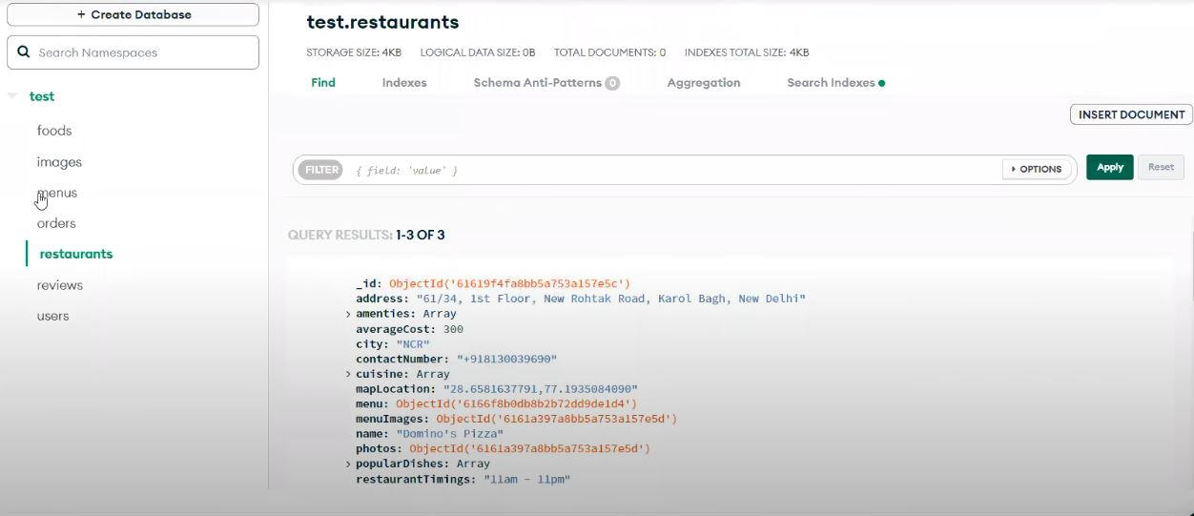
Some Examples In MongoDB
Here, we can see that the DB connection is working as expected.

